Slide 1
The engineering design process
The 5-step design process

Slide 2
The 5-STEP DESIGN PROCESS
Step 1: Identify your problem, need and/ or “customer”.
Step 2: Concepts and ideas.
Step 3: Comprise solutions
Step 4: Models and/ or prototypes
Step 5: Production and or working drawings.
Monday

Slide 3
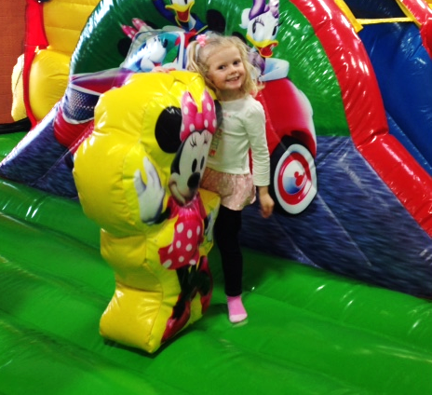
Mackinac Island Toy Design Company
Est. 2011
Design a toy for a 3-5 year old.
Monday

Slide 4
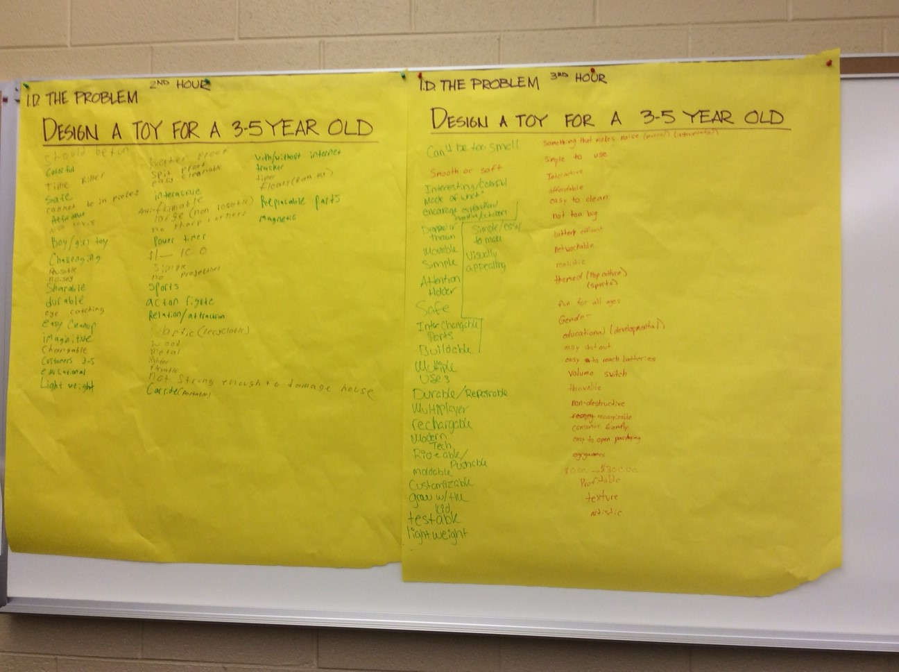
Step 1: Identify your problem, need and/ or “customer”.
Design a toy for a 3-5 year old.
Together as a team lets brainstorm what types of questions we have. There are no stupid questions. (Rest of class period.)
How big or small can the toy be?
What types of safety requirements do we have to address?
Will this be targeted for boys, girls or both?
Etc.
Monday/ 5 Min on Tuesday
Notes:
Have a large sheet of paper to record the brainstorming ideas. Have a student be a “scribe”, Monday and then 5 minutes on Tuesday.

Slide 5
STEP 2: concepts and ideas
Design a toy for a 3-5 year old.
Together as a team lets come up with ideas for types of toys we could design. There are no stupid ideas. (15 minute)
A slide that kids can setup on the stairs and slide down into a pile of fluff.
Colorful blocks with clear faces that have beads inside that make a noise when they are shook.
Farm animal puzzle pieces that stick together with magnets.
Etc…
Tuesday
Notes:
Tuesday: Have a large sheet of paper to record the toy types of ideas. Have a student be a “scribe” (15 minutes)

Slide 6
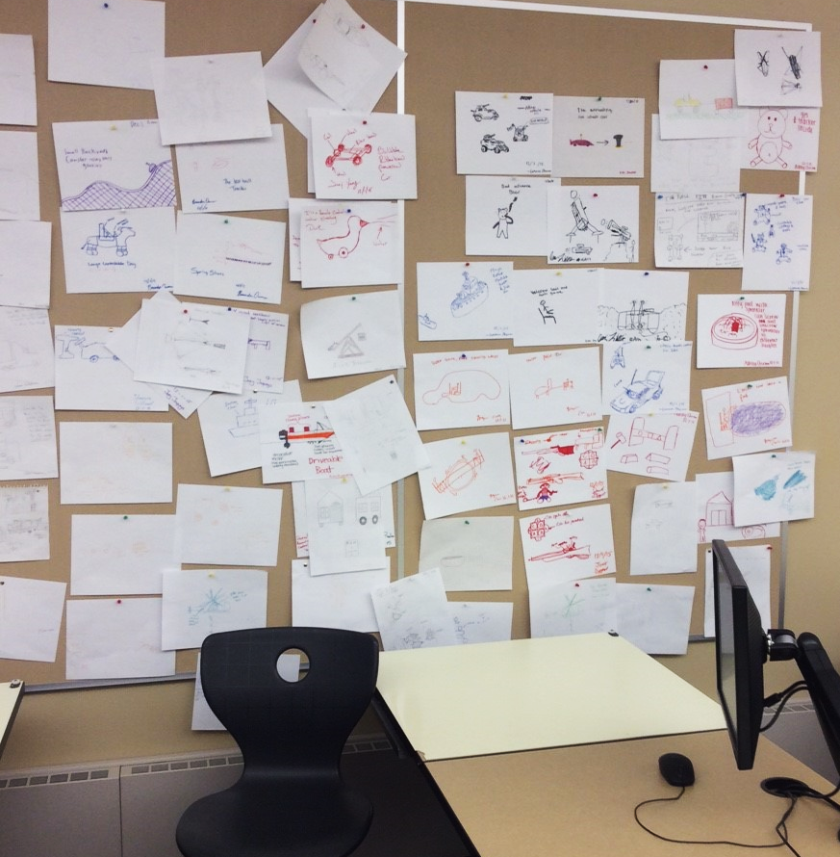
STEP 2: concepts and ideas
Design a toy for a 3-5 year old.
Individually sketch out some ideas that you have for a toy design.(10 minutes)
Sign and date all your sketches and save everything!
Add your sketches to the wall.
Tuesday
Notes:
Have parents use color pencils, markers and paper to sketch out their ideas.
Play “thinking/ sketching” music.

Slide 7
STEP 3: Compromise solutions
Design a toy for a 3-5 year old.
The “adult” has to come out now in us.
Design a toy for a 3-5 year old incorporating a simple machine within it. (Wheel & axle, lever, inclined plane, screw, pulley or wedge) Lets look at what those are.
Individually sketch out some additional ideas that you have for a toy design.(10 minutes)
Your design will be proposed to The Mackinac Island Toy Company. In addition to a model/ prototype and working drawings you will also have to include a business proposal.
Tuesday
Notes:
Tuesday

Slide 8
STEP 3: Compromise solutions
Design a toy for a 3-5 year old.
Research and look what is already in the market and create another more finalized idea sketches and add to the wall. (Individually) (15 minutes)
Introduction of full Mackinac Island Toy Design Project
Wednesday
Notes:
Tuesday

Slide 9
STEP 3: Compromise solutions
Design a toy for a 3-5 year old.
Select a business partner.
Compromise and agree upon a toy design you will work on together.
Sketch out your compromised toy design idea. (10 minutes)
Be ready to present your idea.
Come up with a company name.
Wednesday
Notes:
Have parents partner up and once again use color pencils, markers and paper to sketch out their ideas.
Play “thinking” music.

Slide 10
STEP 3: Compromise solutions
Design a toy for a 3-5 year old.
With your business partner.
Compromise and agree upon a toy design you will work on together.
Finalize your sketch of your agreed upon toy. Sketch out your compromised toy design idea.
Be ready to present your idea.
Come up with a company name.
Be ready to build model/ prototype on Friday.
Thursday
Notes:
Have parents partner up and once again use color pencils, markers and paper to sketch out their ideas.
Play “thinking” music.

Slide 11
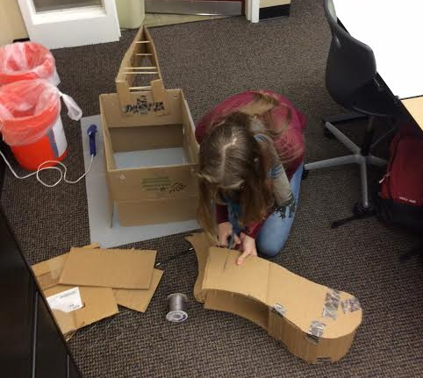
STEP 4: MODELS AND OR prototypes
Design a toy for a 3-5 year old.
Build a model or prototype of your toy. Due Wednesday.
Friday- Wednesday

Slide 12
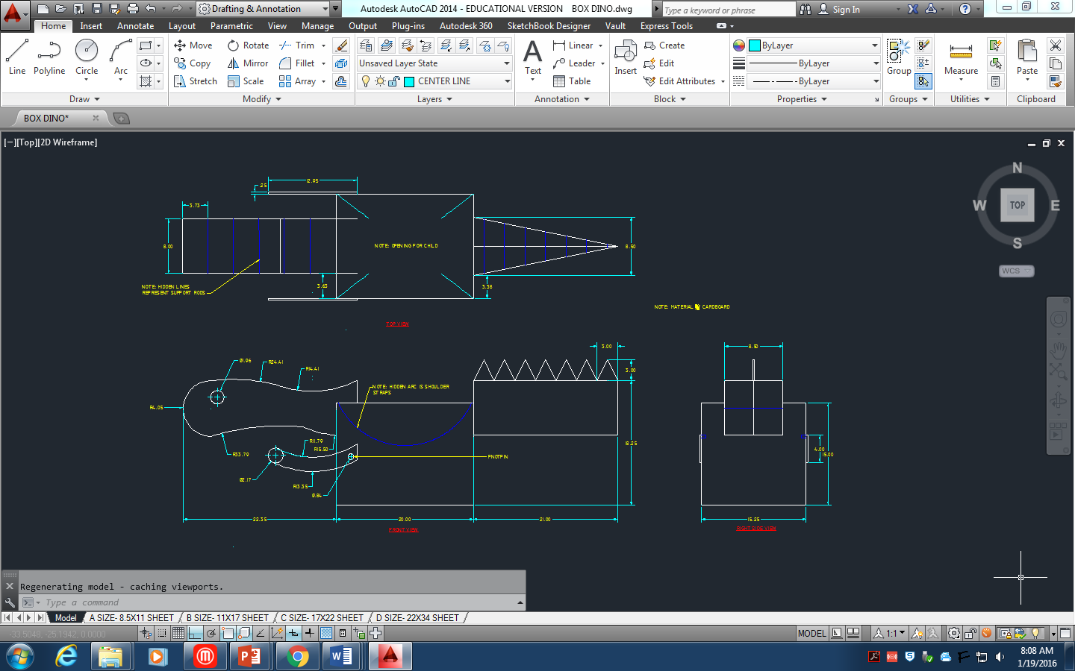
STEP 5: production and or working drawings
Design a toy for a 3-5 year old.
Create drawings so your toy can be manufactured.
Create a business proposal
After break.

